Slide 1
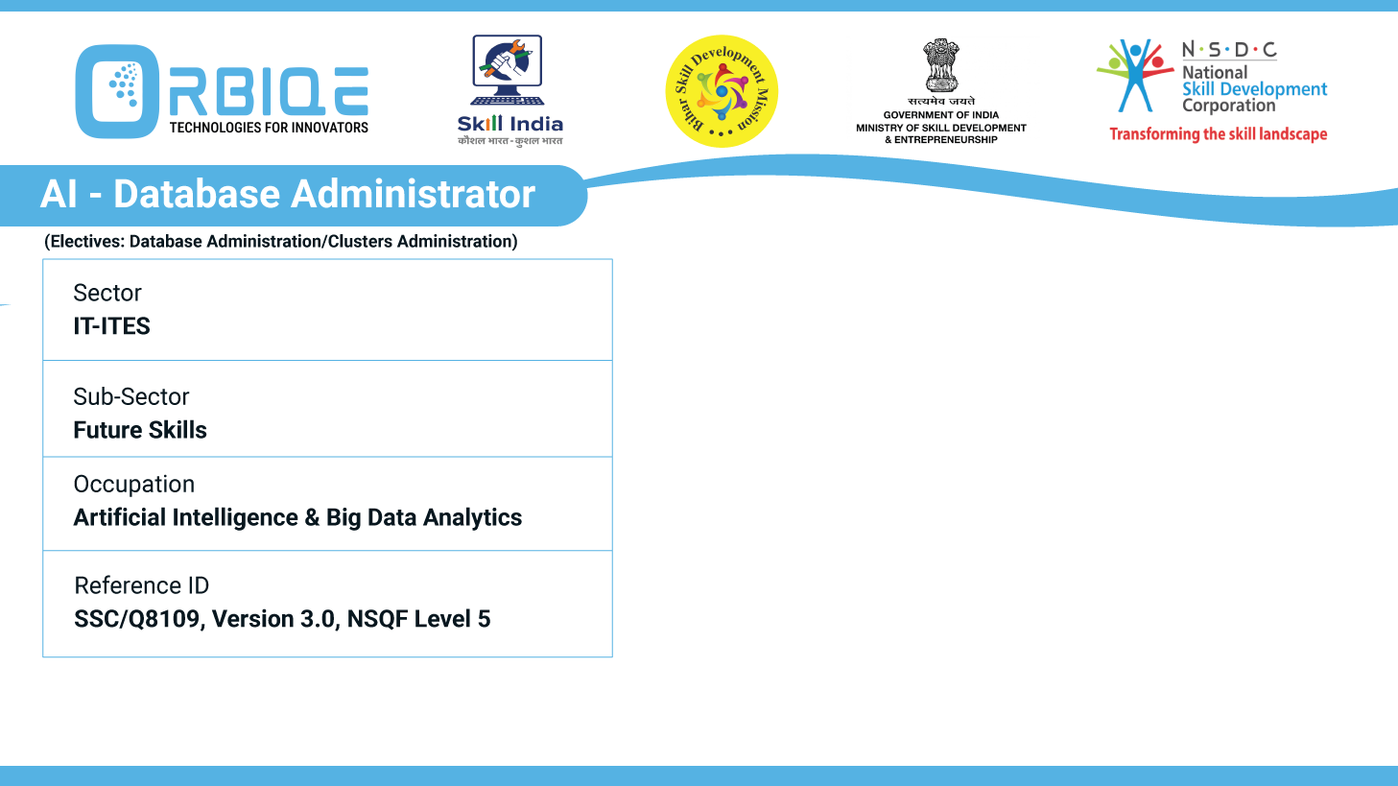
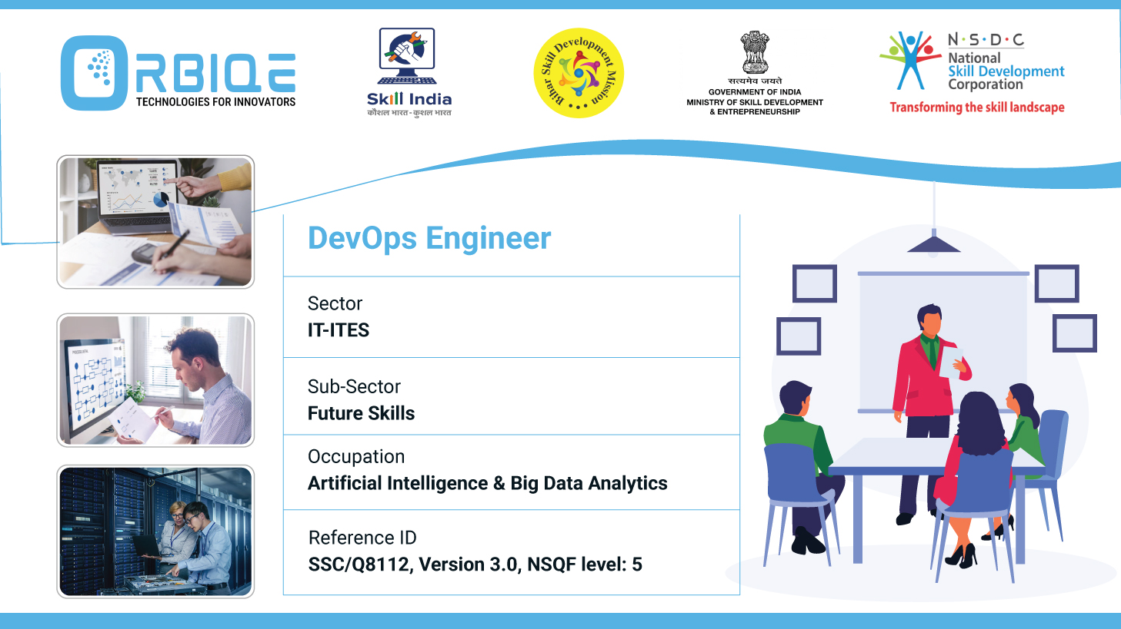
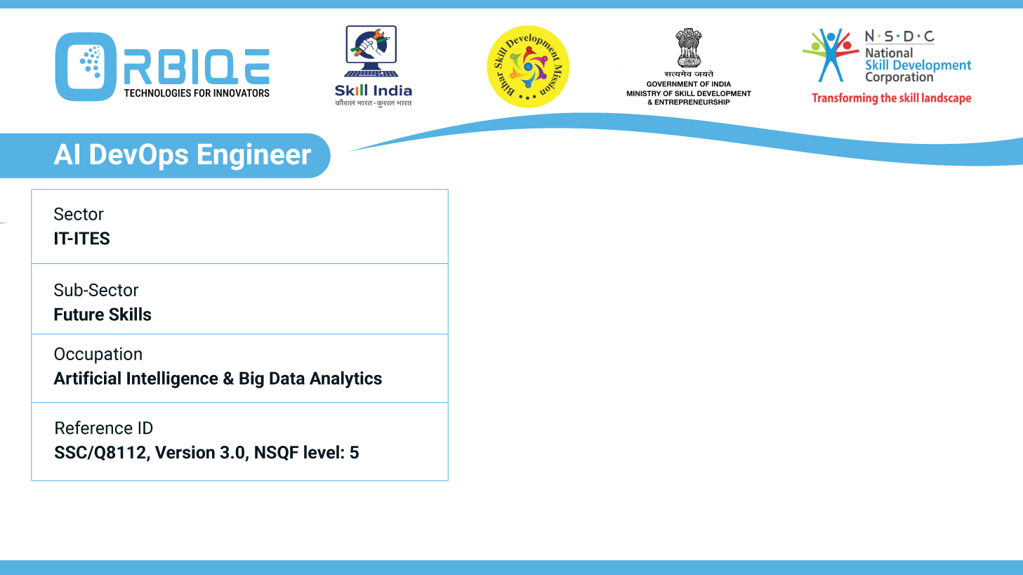
Name- Krishna Kant Dubey

Slide 2

Optimizing Database Performance: Strategies for Efficiency

Slide 3
Agenda
Explore techniques to optimize database performance, focusing on strategies to enhance efficiency and responsiveness in AI Database Administration

Slide 4
Techniques to Optimize Database Performance in AI-Driven Administration
Indexing Strategies
Query Optimization
Caching Mechanisms
Partitioning & Sharding
Concurrency & Locking Control
Storage & I/O Optimization
Monitoring & Predictive Analytics
Automated Maintenance

Slide 5
Indexing Strategies
Composite Indexes: Combine multiple columns to optimize complex WHERE clauses.
Partial Indexes: Index only rows meeting specific conditions (e.g., active users).
Covering Indexes: Include all columns used in a query to avoid table lookups.
AI-Based Index Tuning: Use ML models to analyze query patterns and suggest optimal indexes.

Slide 6
Query Optimization
**Avoid SELECT ***: Fetch only necessary columns.
Use EXISTS instead of IN: More efficient for subqueries.
Parameterization: Prevents repeated parsing and improves cache hits.
AI Query Rewriting: ML models can rewrite inefficient queries based on historical performance.

Slide 7
Caching Mechanisms
Application-Level Caching: Use Redis or Memcached for frequent reads.
Materialized Views: Precompute and store complex query results.
AI-Driven Cache Invalidation: Predict when cached data is stale and refresh intelligently

Slide 8
Partitioning & Sharding
Horizontal Partitioning: Split rows across tables (e.g., by region or time).
Vertical Partitioning: Separate columns into different tables for faster access.
Sharding: Distribute data across multiple servers for scalability.
AI Load Balancing: Predict traffic spikes and redistribute shards dynamically

Slide 9
Concurrency & Locking Control
Optimistic Locking: Avoids locking unless there's a conflict.
Row-Level Locking: Minimizes scope of locks.
AI Conflict Prediction: Forecasts transaction collisions and reroutes queries

Slide 10
Storage & I/O Optimization
Columnar Storage: Ideal for analytics workloads (e.g., Amazon Redshift, ClickHouse).
Compression: Use algorithms like Zstandard or LZ4 to reduce I/O.
AI-Driven Tiering: Move cold data to cheaper storage automatically.

Slide 11
Monitoring & Predictive Analytics
Anomaly Detection: Identify unusual query behavior or resource usage.
Predictive Scaling: Forecast demand and auto-scale resources.
Self-Healing Systems: Detect and resolve deadlocks, failed queries, or node failures

Slide 12
Automated Maintenance
Auto-Vacuuming & Reindexing: Schedule cleanup tasks.
AI-Driven Scheduling: Optimize maintenance windows based on usage patterns.
ETL Optimization: Use AI to batch, parallelize, and prioritize data loads.

Slide 13
Thank You

